Slide 1
Programming paradigms in end-user programming for speech and language therapists
Damir Kalpić Jasna Hamzabegović
University of Zagreb University of Bihać
Faculty of Electrical Engineering Pedagogical Faculty
and Computing Department of Mathematics (FER) and Informatics
Croatia Bosnia and Herzegovina
14th WorkShop DAAD
August 25 – 30, 2014
Sinaia, Romania

Slide 2
Presentation Overview
Overview
INTRODUCTION
The End–User (EU) / The End-User Programmer (EUP)
The Speech and Language Therapist (SLT)
IDENTIFIED ISSUES
PROGRAMMING PARADIGMS
DEVELOPMENT ENVIRONMENT
Visual Development Environment for Component Software Development
CONCLUSION
14th WorkShop DAAD
Sinaia, August 25-30, 2014

Slide 3
*WEBSTER DICTIONARY (http://www.webster-dictionary.org/definition/end-user)
Introduction
The End–User (Eu)
The person who uses an item of commerce for its designed purpose*
(JOB) The person who uses a computer application, as opposed to those who developed or support it. *
The End–User PROGRAMMER (EuP)
The person who writes programs to support some goal in his own domains of expertise (secretaries, accountants, children [Petre and Blackwell 2007], teachers [Wiedenbeck 2005], interaction designers [Myers et al. 2008], scientists [Segal 2007] )**
**A.J. Ko et al.: "The State of the Art in End-User Software Engineering", ACM Computing Surveys, Vol.43, No.3, 2011, pp. 1-44 (http://web.media.mit.edu/~lieber/Publications/End-User-Software-Engineering.pdf)
The Speech and Language Therapist (SLT)
The person who works closely with infants, children and adults who have various levels of speech, language and communication problems *
The specialist who deals with the correction of the speech sounds, the disorders in writing (Dysgraphia), reading (Dyslexia) and mathematical operations (Dyscalculia).
* (http://www.prospects.ac.uk/speech_and_language_therapist_job_description.htm)
Today The Speech and Language Therapist is only end-user

Slide 4
Identified Issues
End-User Development
Prof.Mary Shaw, Carnegie Mellon University
The 7th joint meeting of the European Software Engineering Conference (ESEC) , 2009
US Bureau of Census and Bureau of Labor
In 2005
In 2012
3%
14th WorkShop DAAD
Sinaia, August 25-30, 2014

Slide 5
Identified Issues
Scientific issues and objectives
What are the main hindrances in development of computer applications by the end-users?
How the non-programmers naturally perceive the programming?
Which approaches for application development are feasible for non-programmers?
The development framework and software tools for speech therapists?
The relevant areas:
Software Engineering
Psychology of Programming
End User Development

Slide 6
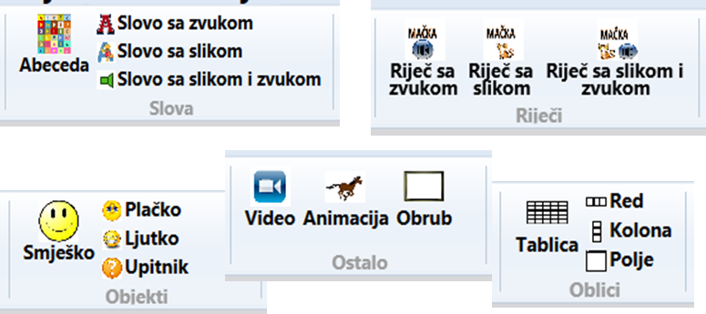
Programming Paradigms
Software Engineering :
The advantages of three paradigms :
  Component Based Software Development,
  Visual Programming,
  Event-Driven Programming.
The components should map concrete artifacts from the therapists practice:
14th WorkShop DAAD
Sinaia, August 25-30, 2014

Slide 7
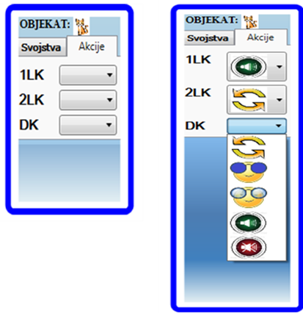
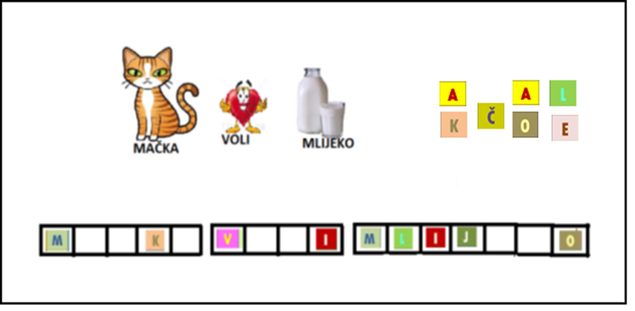
Programming Paradigms
Software Engineering :
Paradigms:
  Component-Based Software Development,
  Visual Programming,
  Event-Driven Programming.
The components shall be visually intuitive to enable visual composition of future application.
Event-driven programming shall enable the software engineers to animate the visual components.
14th WorkShop DAAD
Sinaia, August 25-30, 2014

Slide 8
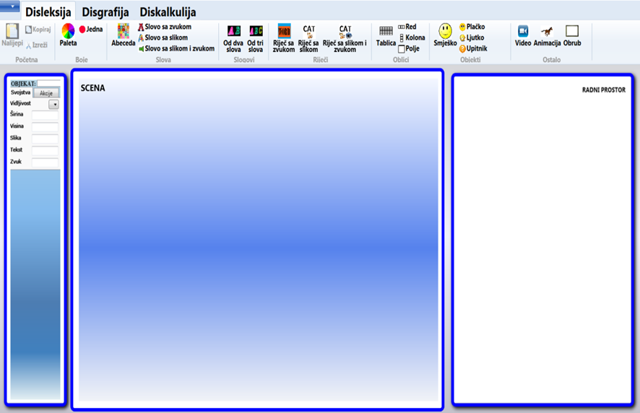
Visual Development Environment for Component Software Development
The framework and a visual language for therapists:
The WYSIWYG editor to simplify the visual design and user-interface building.
The components: intuitive and meaningful units, minimally interdependent, useful, reliable, interoperable, ...
Construction of applications is visualised and debugging and testing are interactive.
Ribbon Bar
Objects
Scene
Workspace
14th WorkShop DAAD
Sinaia, August 25-30, 2014

Slide 9
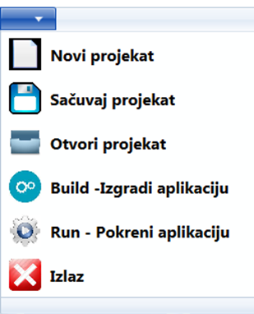
Visual Development Environment for Component Software Development
Development Environment for Speech and Language Therapists (DESLT)
Development Framework Window:
WYSIWYG concept
Techniques:
„point&click“
&
„drag&drop“
C o m p o n e n t s

Slide 10
Visual Development Environment for Component Software Development
From the Therapist’s Point of View
The user interface offers a window with multiple design plates.
Setting Properties of Objects
Instantiation Objects
Scene
Objects
Workspace
Programming
14th WorkShop DAAD
Sinaia, August 25-30, 2014

Slide 11
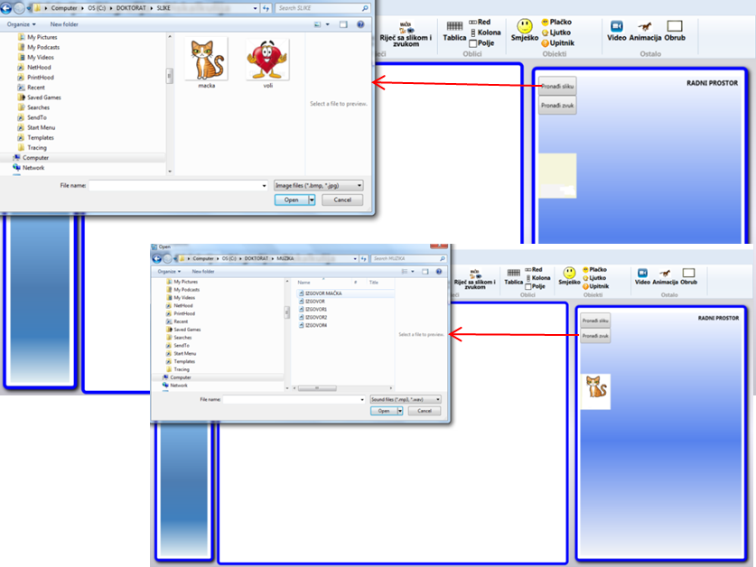

Visual Development Environment for Component Software Development
From the Therapist’s Point of View
The procedure of instantiation of a component

Slide 12
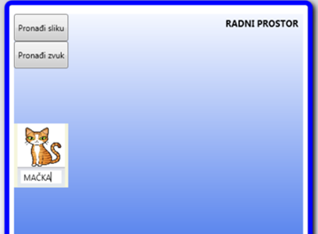

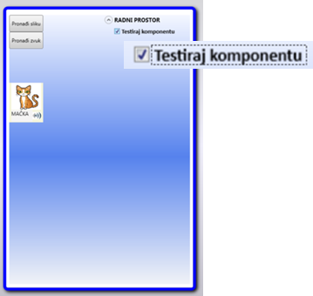
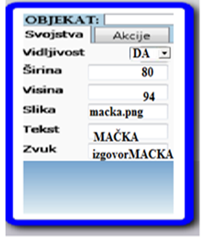
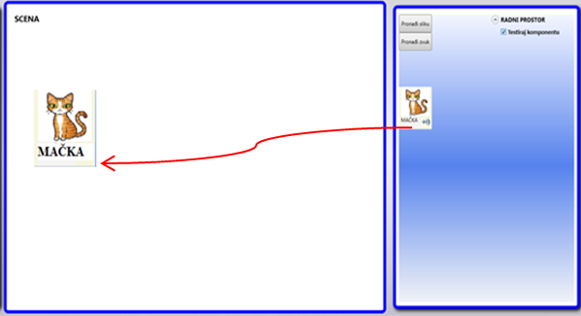
Visual Development Environment for Component Software Development
From the Therapist’s Point of View
The result of instantiation of a component by defining the parameters:
Adjusting the component properties, behaviour and actions:
Testing of the component:
Drag&drop component:
14th WorkShop DAAD
Sinaia, August 25-30, 2014

Slide 13
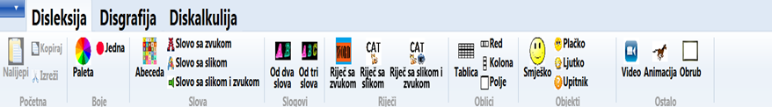
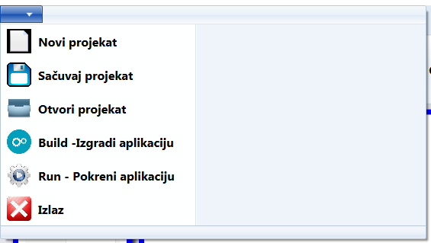
Visual Development Environment for Component Software Development
From the Therapist’s Point of View
DESLT is an intuitive and powerful WYSIWYG environment.
This one is aimed exclusively at development of therapeutic applications for therapists.
For treatment of dyslexia, components have been created and situated in the toolbar:
At any moment, therapist-programmer can run the application by clicking on the button RUN.
The completed application shall be distributed to the patients as a standalone EXE file.
14th WorkShop DAAD
Sinaia, August 25-30, 2014

Slide 14
Visual Development Environment for Component Software Development
From a software engineer’s point of view:
The software component is an independent object bearing its function.
It is an independent executable unit.
The source code need not be available to therapist-programmer and it shall not be compiled with other parts of the future application program.
It publishes its interface and all the related operations are performed through that interface.
The internal component state is not visible.
To build a prototype of the future development framework DESLT, it was used:
  MS Visual Studio 2012 where in programming language C# the functionalities have been implemented,
  MS Expression Blend 4 to create the environment interface that generated a corresponding XAML code.
14th WorkShop DAAD
Sinaia, August 25-30, 2014

Slide 15
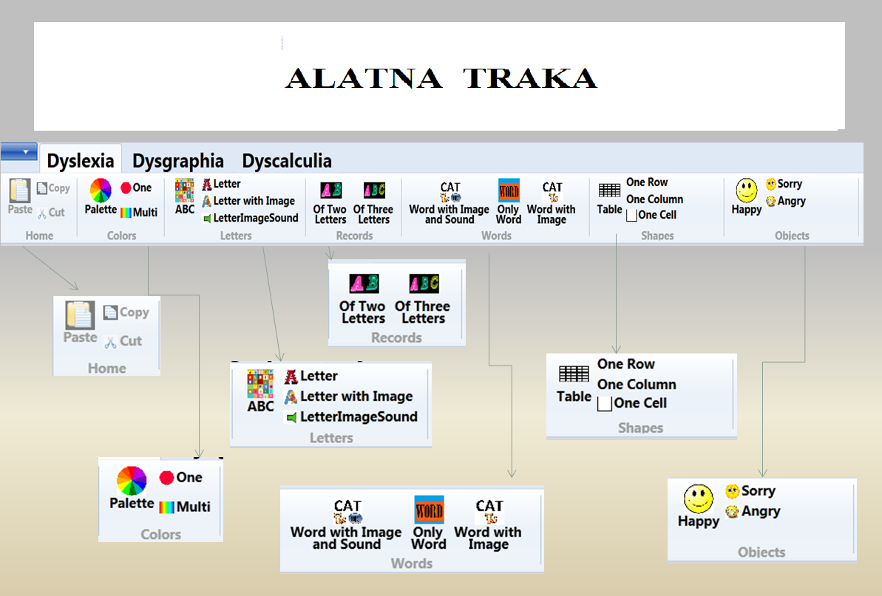
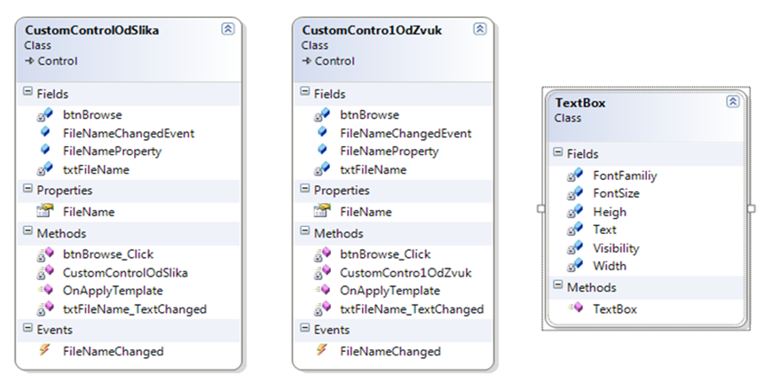
Visual Development Environment for Component Software Development
From a software engineer’s point of view:
The Class Diagram of the component WWPT&S
14th WorkShop DAAD
Sinaia, August 25-30, 2014

Slide 16
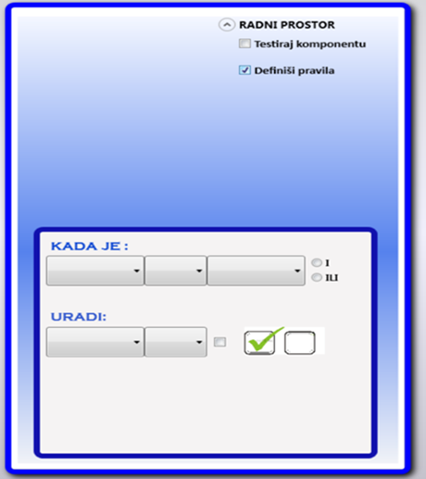
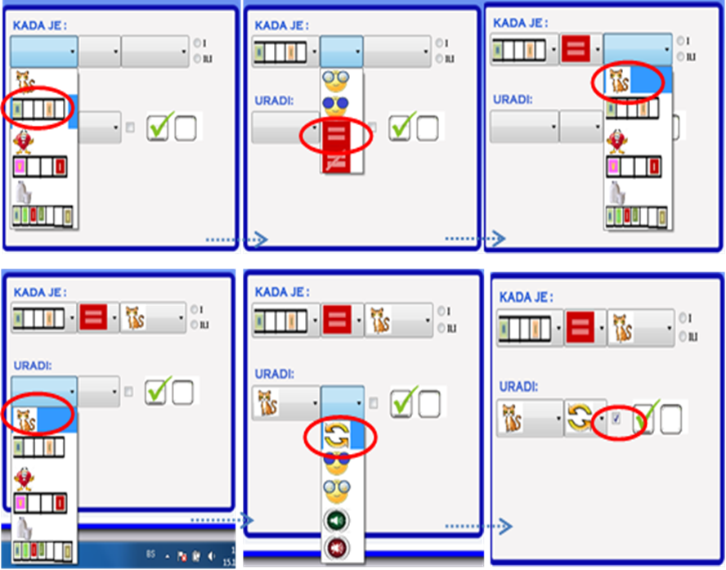
Visual Development Environment for Component Software Development
From a speech therapist and software engineer’s point of view:
The rule: When the property of the Text component Queue is equal to the property Text of the component WWPT&S, rotate the component WWPT&S.
The plate for rules definition
The list of predefined actions: Rotate, Unhide, Hide, StartSound, Mute, ...

Slide 17
CONCLUSION :
Component based software development is a paradigm for development of applications, implementing and combining the existing off-the-shelf components.
Quick and simple development of application programs will rely on available libraries of readymade components.
While involving only a small number of software engineers, the new components could be designed and distributed over the WWW.
The model could support run-time functional queries, enabling to therapist the Web search in order to retrieve the desired components.
The therapist should be able to download and install them in his or her framework, with a single mouse click.
The quick Web transfer can be expected.
The downloaded component shall be self-installable.
14th WorkShop DAAD
Sinaia, August 25-30, 2014

Slide 18
CONCLUSION :
The application programs to help in dyslexia treatment should have the features of the modern windows desktop applications, of Web applications and mobile applications.
Development framework can be built in MS WPF technology.
After having been educated to use the development framework, the therapists may use their primary competence to design the therapeutic applications.
Empowering of therapists as end-users in development of proprietary application programs, may initiate and support the professionals in other areas to become creators of software to fulfil their own needs.
Current programming paradigms make it possible!

Slide 19
Thank You
for Your Attention!
14th WorkShop DAAD
Sinaia, August 25-30, 2014

